Slide 1

CSE 350 Digital Electronics and Pulse Techniques
Transistor-Transistor Logic
Course Instructor: Shomen Kundu (SDU)
Mail: shomen.kundu@bracu.ac.bd
Desk: 4N148

Slide 2
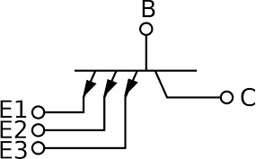
Transistor-Transistor Logic (TTL)
Transistor-Transistor Logic (TTL): TTL is a digital logic family that uses bipolar junction transistors (BJTs) for logic operations.
Multi-Emitter Transistors: A BJT with multiple emitters is shown here.
The operating mode of the BJT depends on the emitter voltages.

Slide 3
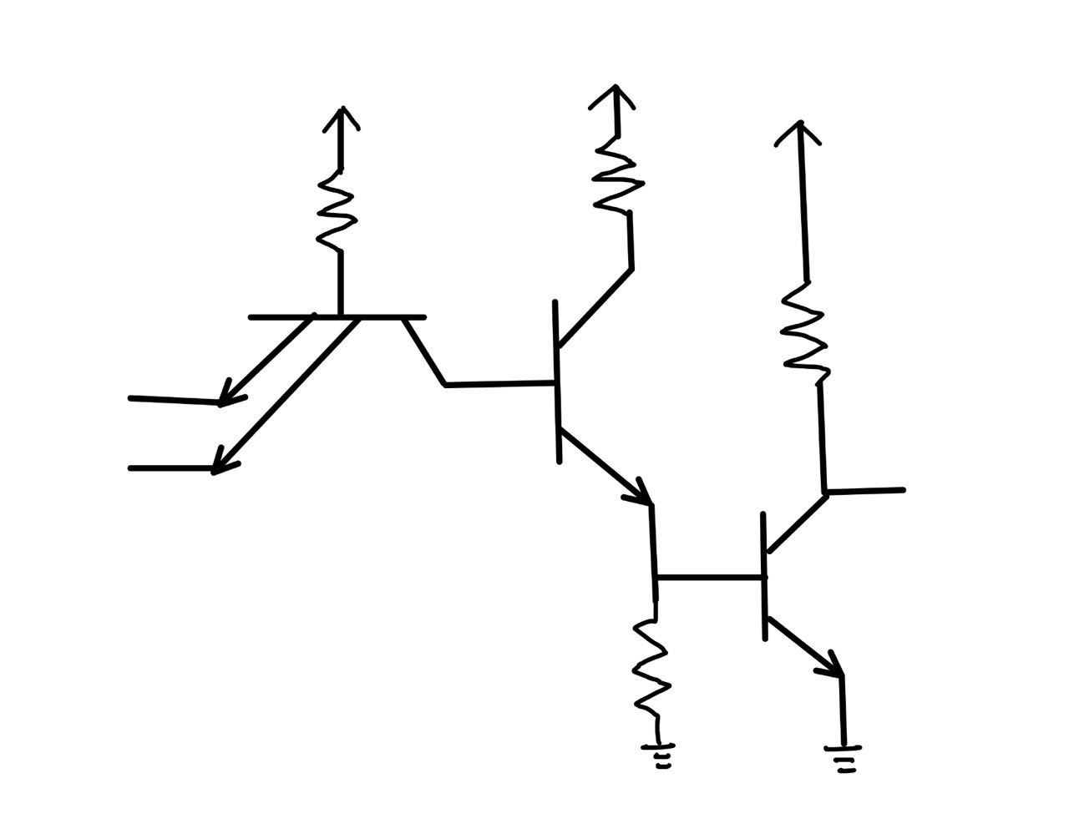


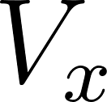

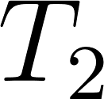
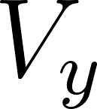


Transistor-Transistor Logic (TTL)
Operation of a TTL Circuit: Find the current and voltages involved in the following TTL circuit. Verify that it works like a NAND gate.

Slide 4
Transistor-Transistor Logic (TTL)
TTL NAND Gate:
Logic Low: 0.1 V
Logic High : 5 V
We need to analyze the TTL NAND gate circuit for four different cases.
0.1 | 0.1
0.1 | 5
5 | 0.1
5 | 5

Slide 5
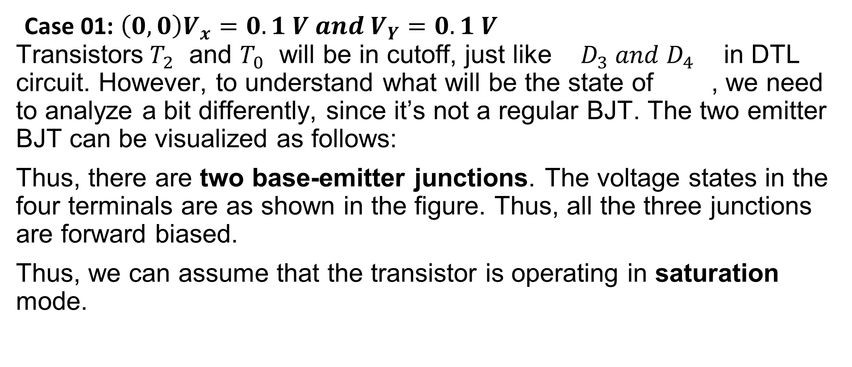
Transistor-Transistor Logic (TTL)

Slide 6
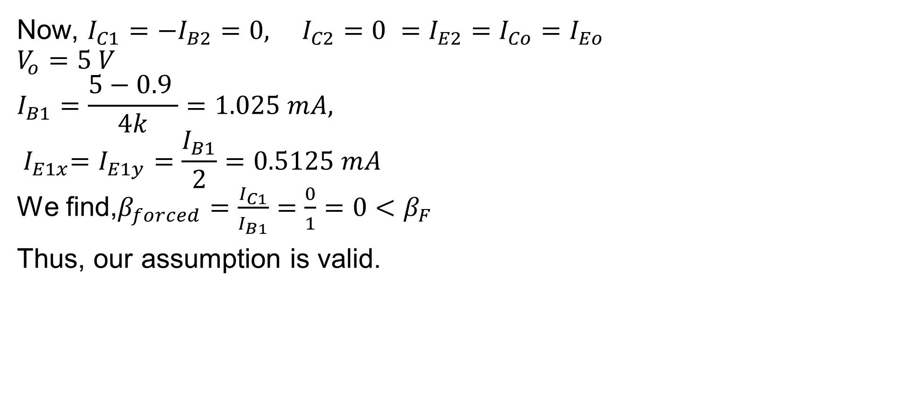
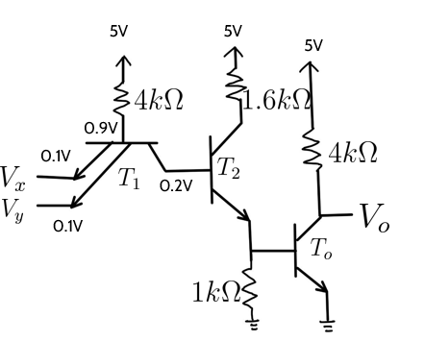
Transistor-Transistor Logic (TTL)

Slide 7
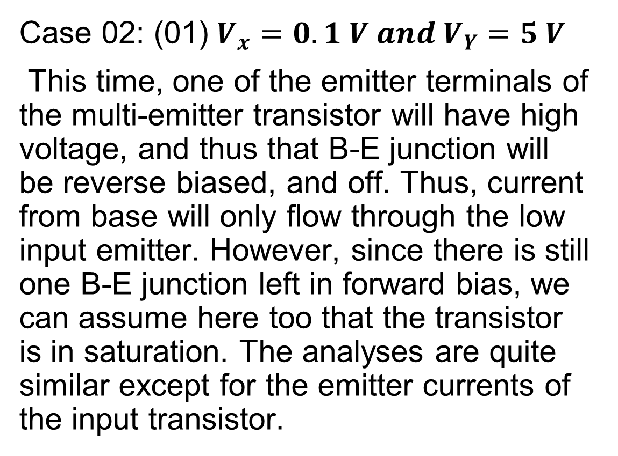
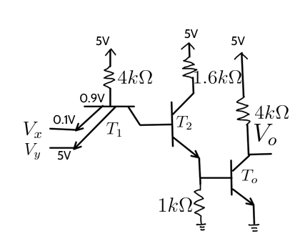
Transistor-Transistor Logic (TTL)

Slide 8
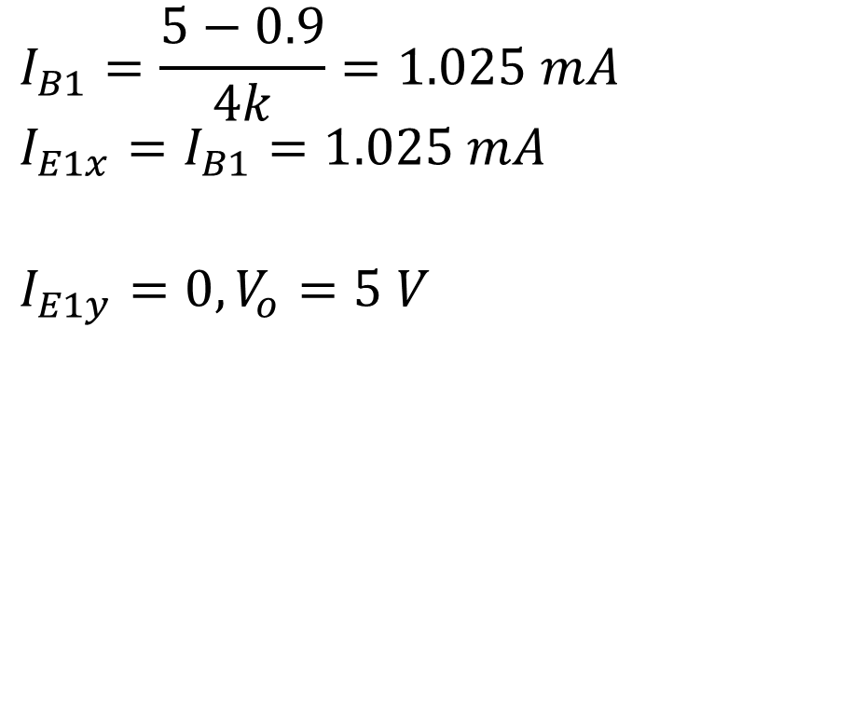
Transistor-Transistor Logic (TTL)

Slide 9
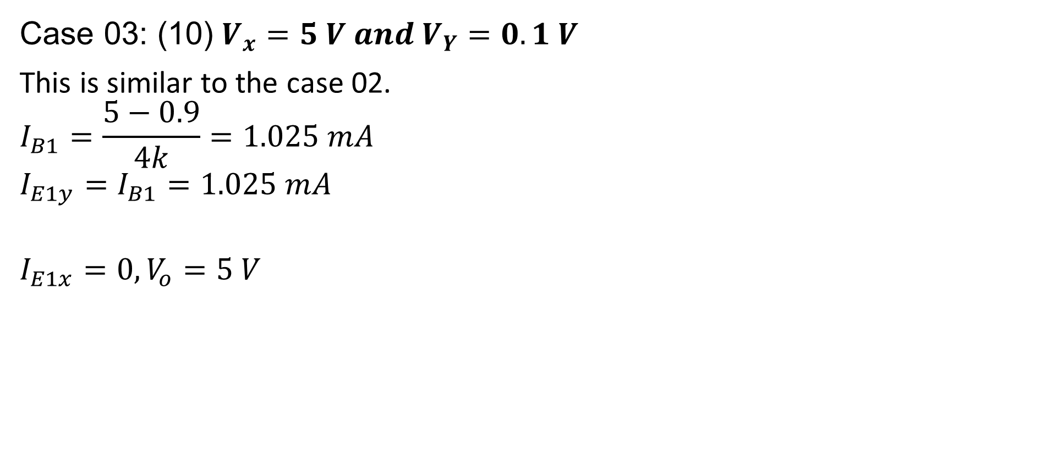
Transistor-Transistor Logic (TTL)

Slide 10
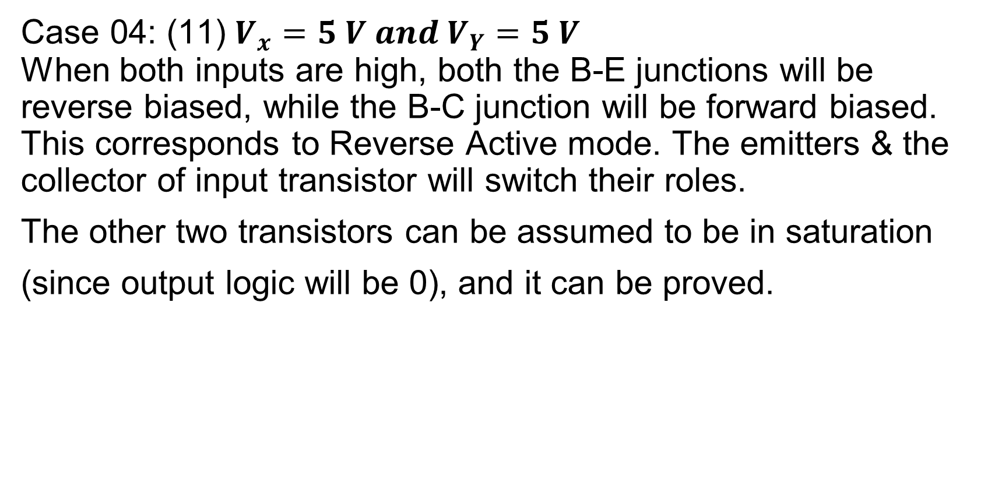
Transistor-Transistor Logic (TTL)

Slide 11
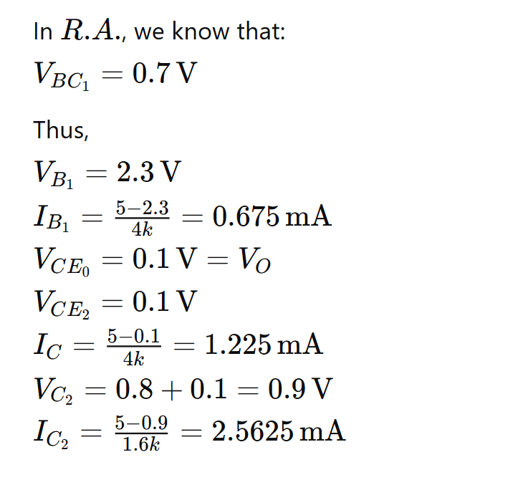
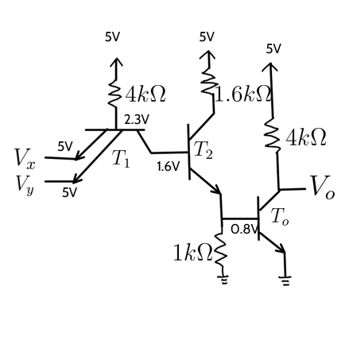
Transistor-Transistor Logic (TTL)

Slide 12
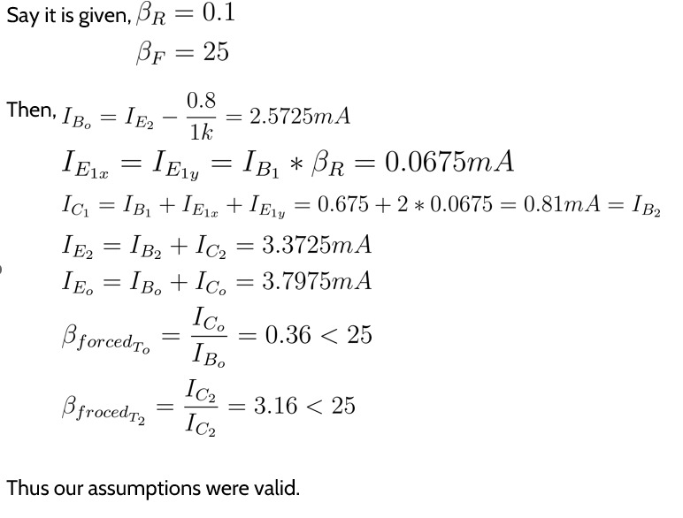
Transistor-Transistor Logic (TTL)

